Slide 1
Asset Management System
Siddhant N. Roundalkar Bhagyashree B. Patil Avadhut G. Sakhare

Slide 2
Introduction to Asset Management System
Objective:
Efficient tracking and management of company/personal assets.
Key Features:
- Asset allocation, tracking, and maintenance.
- Role-based access control for admins and sub-admins.
- Integration with finance and procurement processes.

Slide 3
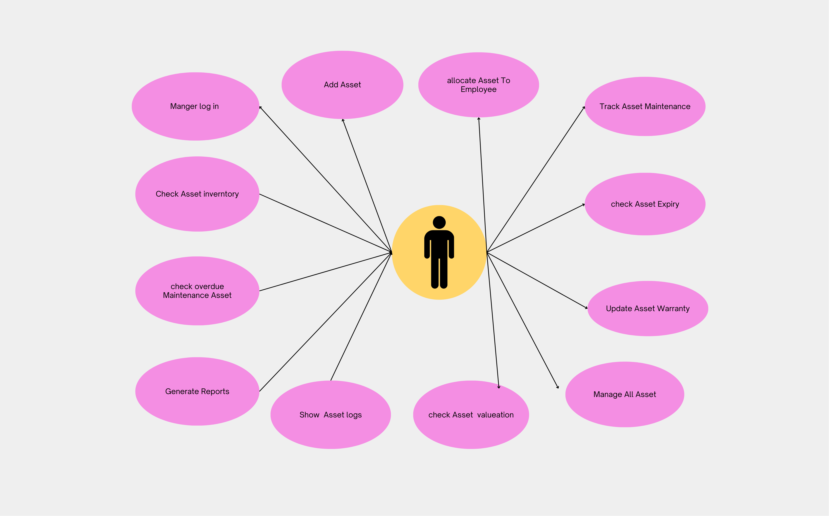
USE CASE DIAGRAMS Asset-MANAGER

Slide 4
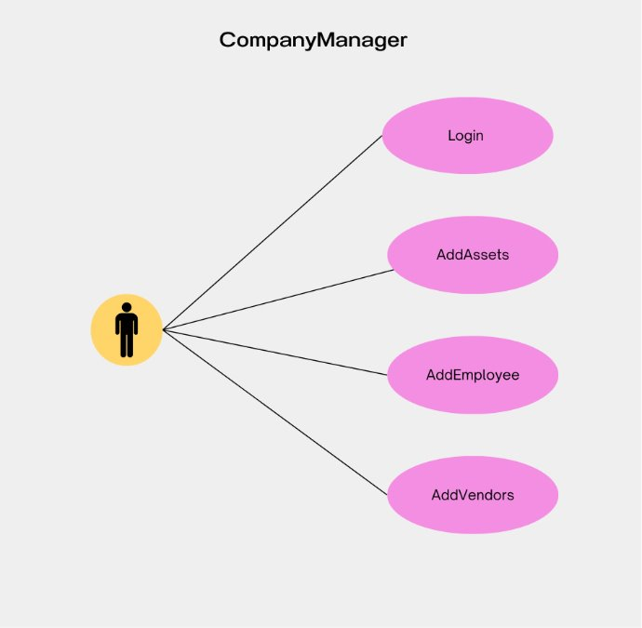

Slide 5
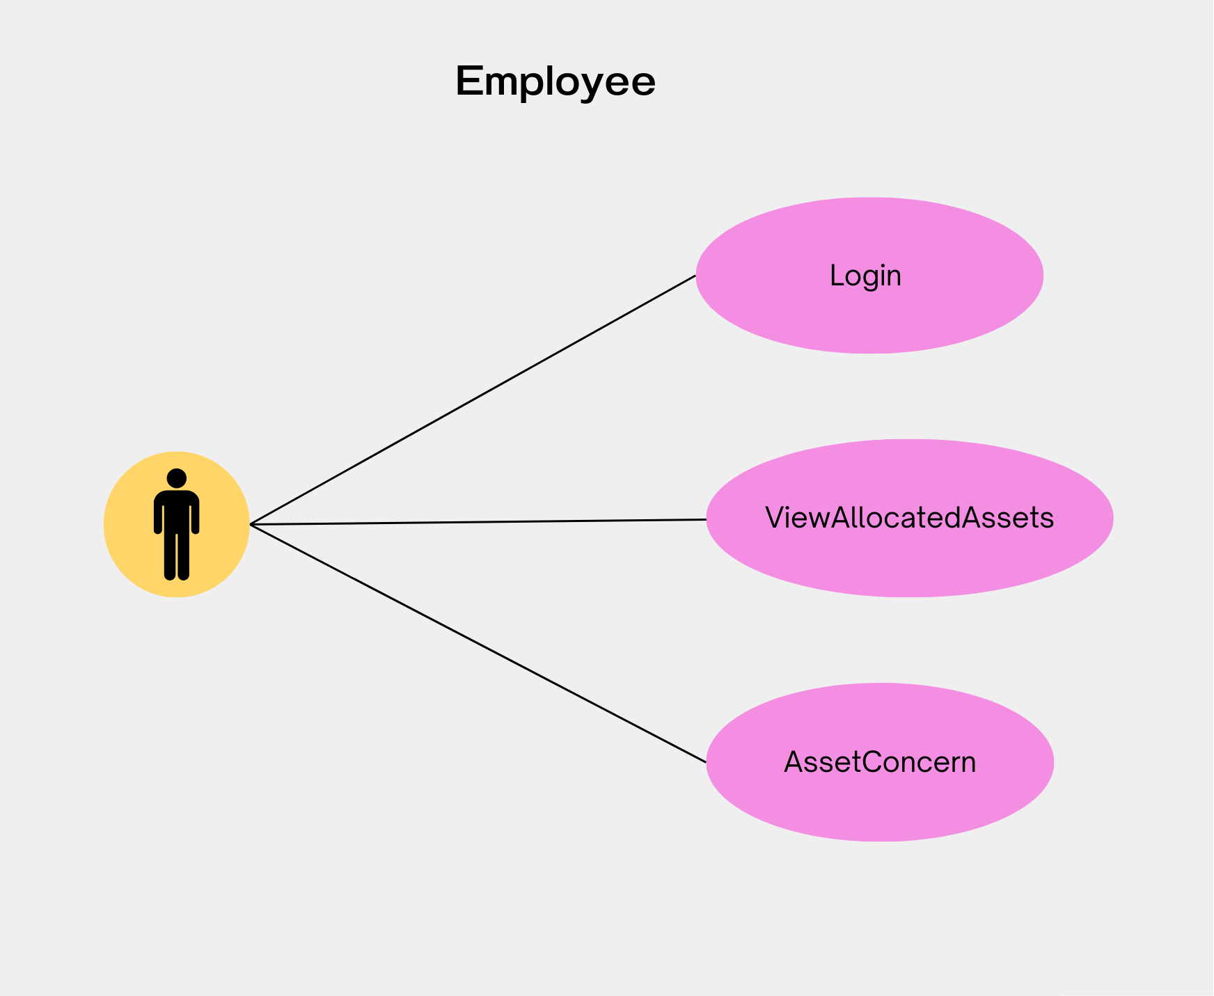
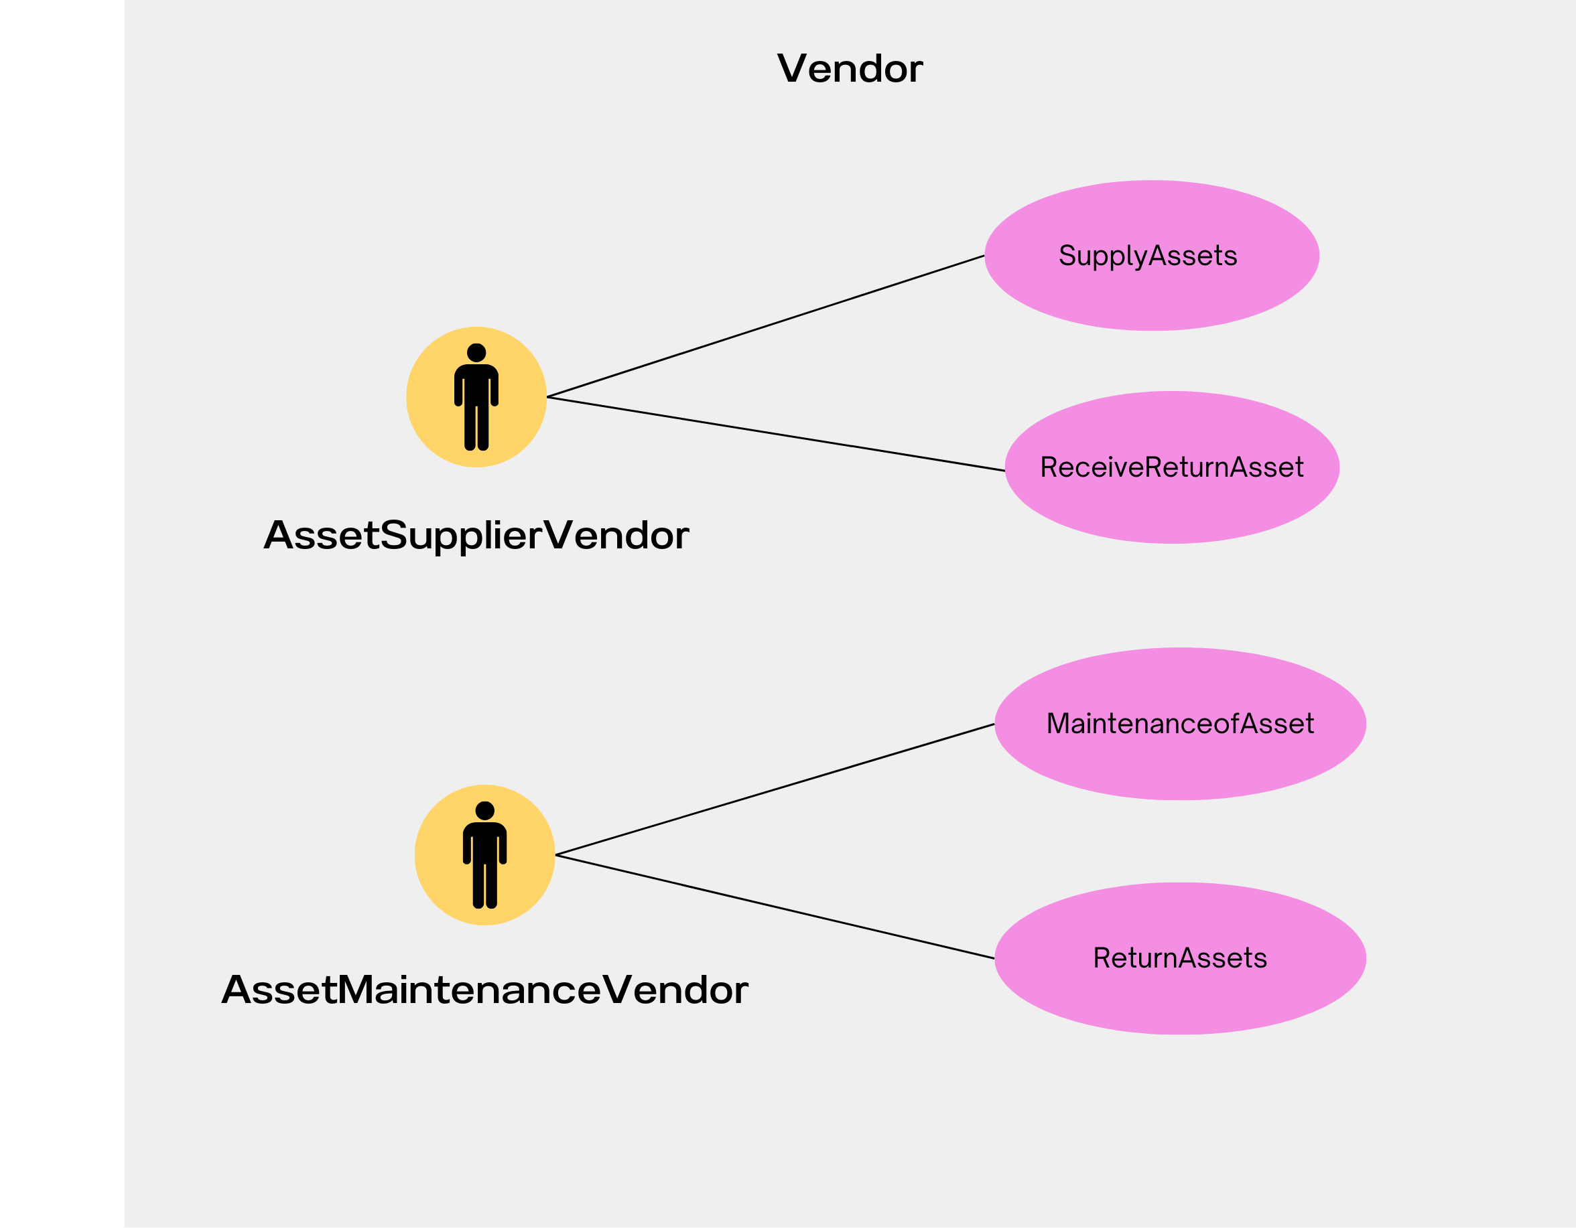

Slide 6
Changes Based on Feedback:
Tangible and Intangible Assets Subtypes:
In the previous diagram, subtypes of Tangible(e.g. Hardware, furniture) and Intangible assets(e.g. Software's, licences ) were represented as subclasses. This has been updated to use Enums, allowing asset managers to easily add new subtypes (e.g., "Car" under Tangible Assets) without modifying the code.
Asset Allocation Logs:
Two new classes were added:
EmployeeAssetsLogs: Tracks assets allocated to employees.
AssetsLogs: Maintains a record of all company-owned assets.
--The next slide contains the updated UML diagram.

Slide 7
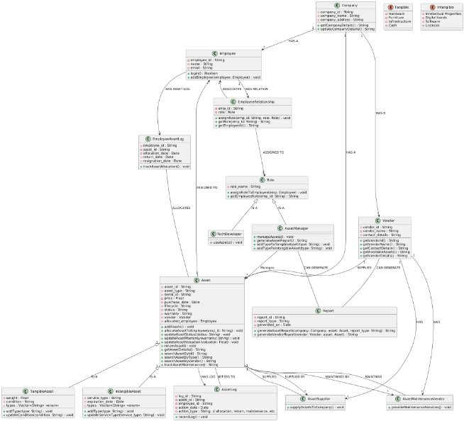

Slide 8
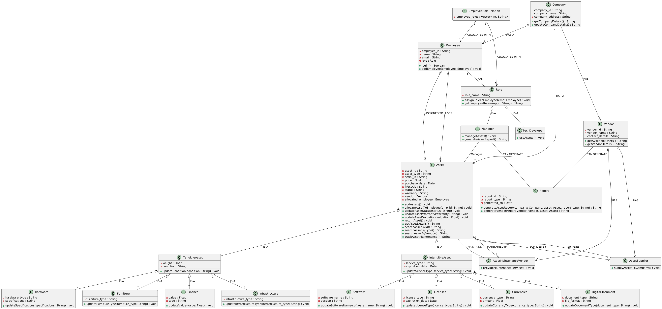
Previous Class diagram

